Slide 1
Module 5: Platforms for Data Science
Basics of Python for Data Science
Python Libraries: Data Frame Manipulation with numpy and pandas
Exploration Data Analysis with Python
Time Series Data
Clustering with Python
ARCH and GARCH
Dimensionality Reduction
Python IDEs for Data Science

Slide 2
Module 5: Platforms for Data Science
Basics of Python for Data Science
Python Libraries: Data Frame Manipulation with numpy and pandas
Exploration Data Analysis with Python
Time Series Data
Clustering with Python
ARCH and GARCH
Dimensionality Reduction
Python IDEs for Data Science

Slide 3
Basics of Python for Data Science
Data science is a combination of different tools, algorithms, and machine learning concepts to discover hidden insights from raw data.
The notable factor to use Python in data science is the availability of different libraries for data science or data analytics.
NumPy (for array-based data manipulation), pandas (for labeled data manipulation), SciPy (for scientific computing), and scikit-learn (for ML algorithms) are a few among the many libraries that are generally used in data science.

Slide 4
Python Identifiers
A Python identifier is a name that consists of a series of letters, numbers, and underscore characters to identify a variable, function, class, module or other object.
A Python identifier should follow the below naming conventions:
Variable and function names start with a lowercase letter.
An identifier starting with an underscore character generally indicates it to be a private identifier.
Classes name begins with an uppercase letter.
The identifier cannot hold names among the reserved Python keywords (you can get the list of Python keywords using help() built-in function).

Slide 5
Python Variables
Python has no syntax or command to declare a variable.
The name assigned to a variable is its variable.
It can also be called as a Python identifier.
These variables are case sensitive and should ideally begin with a letter.
To improve the readability of the variable name, it is better to use lowercase-lettered words which are separated using an underscore character, for example, mixed_case, data_des, etc.

Slide 6
Python Data types
Python supports many basic data types, such as integer, floating-point, character, or string.
In Python, we need not declare the data type assigned for the variable.
Instead, the Python interpreter identifies the data type of the variable using the value assigned to it.
The other two data types are Boolean and None.
The Boolean data type takes two values: True or False.
The None data type indicates a null value.

Slide 7
Python Data types
In[1]: # An integer value
In[2]: # A string of characters
x = 12
type(x)
Out[1]:int
x=’Hello!’
type(x)
Out[2]:str
In[3]: # A float value
In[4]:# A Boolean Value
x = 3.4
type(x)
Out[3]: float
x=False
type(x)
Out[4]:bool
In[5]: # A None value
x = None
type(x)
Out[5]:NoneType

Slide 8
Python Data Structures
There are four data structures in Python:
List
Tuple
Dictionary
String

Slide 9
Python lists
Python lists are ordered with a certain count.
The values in the lists are enclosed in square brackets and are separated using commas.
The list indices start with 0.
The list can hold both homogenous (i.e., [1, 6, 4, 7]) as well as heterogeneous (i.e., [1, ‘a’, ‘d’, 4, 6]) data.
Lists are mutable in Python and thus can be altered by adding new items, deleting some items, or modifying the existing items.

Slide 10
Python lists
A list can be created in four different ways:
Comma-separated values − [2, 5, 3, 8, 3]
Empty list − []
Singleton list −[a]
Using list () function

Slide 11
Python lists
A list can be accessed using the following index numbers:
In[6]:
list = [1, 2, 3, 4, 5, 6, 7, 8, 9];
print ("list[6]: ", list[6]) # prints the item at the 6th position
print("list[2:7]: ", list[2:7]) # prints the items from 2nd to 6th position
print("list[:6]: ", list[:6]) # prints the items till 6th position
print("list[7:]: ", list[7:]) # prints the item from the 8 th position
print("list[:-1]: ", list[:-1]) # prints upto last
item in the list
print("list[::-1]: ", list[::-1])# reverses the list
Out[6]:
list[6]: 7
list[2:7]: [3, 4, 5, 6, 7]
list[:6]: [1, 2, 3, 4, 5, 6]
list[7:]: [8, 9]
list[:-1]: [1, 2, 3, 4, 5, 6, 7, 8]
list[::-1]: [9, 8, 7, 6, 5, 4, 3, 2, 1]

Slide 12
List Updation
Modyfying the existing items:
In[7]:
list = [1, 2, 3, 4, 5, 6, 7,8,9];
print ("Value at index 4 : )
print (list[4])
list[4] = 12;
print( "New value at index 4 : ")
print (list[4])
Out[7]:
Value at index 4 : 5
New value at index 4 : 12

Slide 13
Adding new items
In[8]:
list = [1, 2, 3, 4, 5, 6, 7, 8, 9];
print(list)
list.append(11)
print(list)
Out[8]:
[1, 2, 3, 4, 5, 6, 7, 8, 9]
[1, 2, 3, 4, 5, 6, 7, 8, 9, 11]

Slide 14
You can also append an entire list into the existing list.
In[9]:
list = [1, 2, 3, 4, 5, 6, 7, 8, 9];
print(list) list.append([11,12,13])
print(list)
Out[9]:
[1, 2, 3, 4, 5, 6, 7, 8, 9]
[1, 2, 3, 4, 5, 6, 7, 8, 9, [11,12,13]]

Slide 15
Deleting items in the list
In[10]:
list = [1, 2, 3, 4, 5, 6, 7,8,9];
print(list)
del list[2];
print(list)
Out[10]:
[1, 2, 3, 4, 5, 6, 7, 8, 9]
[1, 2, 4, 5, 6, 7, 8, 9]
The items in the list can also be deleted using the remove() function.

Slide 16
Tuple
A tuple is a collection of ordered elements and is immutable.
Any sort of modification in the tuple is prohibited and needs the creation of a new tuple.
Same as lists, a tuple can hold homogenous and heterogeneous data.
All the items in the tuple are enclosed in parenthesis and are separated using commas.

Slide 17
Tuple
Tuple can be created in the following ways:
Comma-separated values – (2, 5, 3, 8, 3)
Empty tuple – ()
Singleton tuple – (a,)
Note: Even when creating a single-valued tuple, a comma must be included after the value.
Using the tuple () function

Slide 18
Tuple
A tuple can be accessed as follows:
In[11]:
tup = (‘a’, ‘b’, ‘c’, ‘d’, ‘e’, ‘f’);
print ("tup [5]: ", tup[5])# prints the item at the 5th position
print("tup [2:4]: ", tup [2:4])# prints the items from 2nd to 3rd position
Out[11]:
tup [5]: f
tup [2:4]: (c, d)

Slide 19
Tuple
Tuple updation:
In[12]:
tup1 = ('a', 'b', 'c', 'd', 'e', 'f’)
tup2=(1,2,3,4)
tup3=tup1+tup2
print(tup3)
Out[12]:
('a', 'b', 'c', 'd', 'e', 'f', 1, 2, 3, 4)

Slide 20
Tuple
Deleting tuple:
As the tuple is immutable, the entire tuple is deleted using the del() function.
In[13]:
print (tup1);
del tup1;
print ("After deleting tup : ");
print (tup1);
Out[13]:
('a', 'b', 'c', 'd', 'e', 'f')
After deleting tup :
NameErrorTraceback (most recent call last)
<ipython-input-85-af0fc5861ae2> in <module>()3
2 del tup1;
3 print ("After deleting tup : ");
----> 4 print (tup1);
NameError: name 'tup1' is not defined

Slide 21
Dictionary
A dictionary is an unordered sequence that contains key-value pairs.
A dictionary has unique keys, but the values can be repeated.
The keys in the dictionary are immutable, whereas the value can have any type.
Keys and values are separated using a colon, and the whole dictionary is enclosed in curly brackets.

Slide 22
Dictionary
Accessing values in Dictionary
In[14]:
dict = {
"Name": "Pallavi",
"Age": "23",
"College": "PCCOE"
}
print(dict)
dict["Name"]
Out[14]:
{'Name': 'Pallavi', 'Age': '23', 'College': 'PCCOE’}
'Pallavi’

Slide 23
Dictionary
Updating the dictionary:
In[15]:
dict = {
"Name": "Pallavi",
"Age": "23",
"College": "PCCOE"
}
dict["Age"]=22
print(dict)
Out[15]:
{'Age': 22, 'College': 'PCCOE', 'Name': 'Pallavi'}

Slide 24
Dictionary
Deleting dictionary items:
Every element in the dictionary can be deleted individually or as a whole. Also, the entire dictionary can be deleted.
In[16]:
del dict['Name'];
print(dict)
Out[16]:
{'Age': '23', 'College': 'PCCOE'}

Slide 25
Dictionary
Clearing all the values in dictionary:
In[17]:
dict.clear();
print(dict)
Out[17]: {}
The entire dictionary can be deleted using del dict.

Slide 26
String
A string is a combination of zero or more characters enclosed in single quotes or double quotes.
Python treats single quotes the same as double quotes and vice versa.
Creating a string is the same as assigning the value to a variable in Python.

Slide 27
String
String manipulations:
In[18]:
str1 = 'This is an example of String Manipulation in Python’
print(str1)
print(str1[0:13])
print(str1[43:])
print('Text length = ', len(str1)) print('Upper case:', str1.upper()) print('Lower case:', str1.lower())
Out[18]:
This is an example of String Manipulation in Python
This is an ex
n Python
Text length = 51
Upper case: THIS IS AN EXAMPLE OF STRING MANIPULATION IN PYTHON
Lower case: this is an example of string manipulation in python

Slide 28
String Modification
In[19]:
str1 = "String"
print("Text before Modification:", str1)
print()
str1 += ' Modification!'
print("Text After Modification:", str1)
Out[19]:
Text before Modification:String
Text After Modification: String Modification!

Slide 29
Module 5: Platforms for Data Science
Basics of Python for Data Science
Python Libraries: Data Frame Manipulation with numpy and pandas
Exploration Data Analysis with Python
Time Series Data
Clustering with Python
ARCH and GARCH
Dimensionality Reduction
Python IDEs for Data Science

Slide 30
Python Libraries: DataFrame Manipulation with pandas and NumPy
Python provides its large library support for various stages in data science.
Python libraries contain various tools, functions, and methods to analyze data. Each library has its focus on data mining, data visualization, etc.
There are various Python libraries used for data science. Some of them are listed below:
Data mining (Libraray)
Scrapy
BeautifulSoap

Slide 31
Python Libraries: DataFrame Manipulation with pandas and NumPy
2. Data processing and modeling
NumPy
pandas
SciPy
Scikit-learn
XGBoost
3. Data visualization
Matplotlib
Seaborn
Pydot
Plotly

Slide 32
pandas
pandas is a free Python data analysis and data handling software library.
pandas provides a variety of high-performance and convenient data structures along with operations for data manipulation.
pandas is also known for its range of tools for reading and writing data between in-memory data structures and various file formats.
The standard form to import the pandas module is:
In[20]: import pandas as pd
Note: pd is just an alias. Any name can be used as an alias.

Slide 33
pandas
Load and examine the dataset:
DataFrame is a two-dimensional array where each feature (column) is simply a shared index series.
A DataFrame can be viewed as a generalization of the NumPy array.
A dataset can be read and loaded to the pandas DataFrame using the below code syntax:
In[21]: df = pd.read_csv('iris.csv')

Slide 34
pandas
The first glance at the dataset can be made using the following functions:
head() – This built-in function displays the first five rows by default. Passing any integer in the function will display that many certain rows starting from the top.
tail() – This built-in function displays the last five rows by default. Passing any integer in the function will display that many certain rows from the bottom.

Slide 35
pandas
sample() – This built-in function displays a random row from the dataset. Passing any integer in the function will display that many random rows.
Syntax: DataFrame.sample()
info() – This built-in function displays a complete summary of the dataset, including the no. of rows, columns, the data types of the features, the null values, etc.
Syntax:DataFrame.info()
describe() – This built-in function displays comprehensive statistics that sums up the central tendency, the shape of the dataset, and dispersion.
Syntax:DataFrame.describe()

Slide 36
Pandas-DataFrame Indexing
loc() – This function is used for label-based indexing. This method recovers rows that get only labeled index as input and return rows.
Syntax: pandas.DataFrame.loc[]
In[22]:
import pandas as pd
data = pd.read_csv('Downloads//MovieData.csv', index_col ="director_name")
first = data.loc["Gore Verbinski"]
first.head(10)

Slide 37
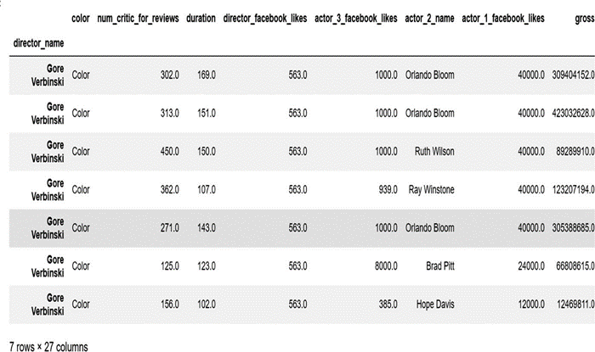
Pandas-DataFrame Indexing
Out[22]:
Usage of the loc() function

Slide 38
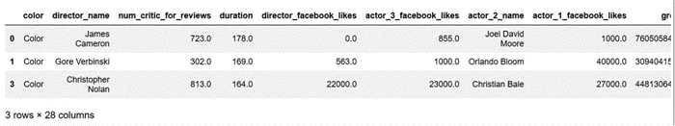
Pandas-DataFrame Indexing
iloc(): This method retrieves rows using integer-based indexing.
In[23]:
import pandas as pd
data = pd.read_csv('Downloads\\MovieData.csv')
first = data.iloc[[0,1,3]]
Out[23]:
Usage of the iloc() function

Slide 39
Pandas-Data frame operations
Sort the data frame
The data frame can be sorted in two ways:
sort_index – This method sorts the data frame based on the index of the certain values.
sort_values – This method sorts the data frame based on the values in the specified columns.

Slide 40
Pandas-Data frame operations
The sort functions create a new data frame of the sorted values.
To make the change in the same data frame, set the inplace attribute to True.
The sort functions sort the data frame in the ascending order by default i.e., the ascending order is set to True by default.
Change the value to this parameter to True or False as per the requirements.

Slide 41
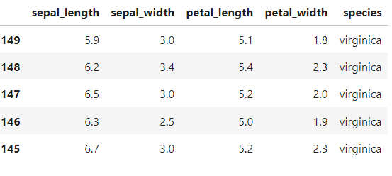
Pandas-Data frame operations
In[24]: data.sort_index(ascending=False).head()
Out[24]:
Sorting the index in the descending manner

Slide 42
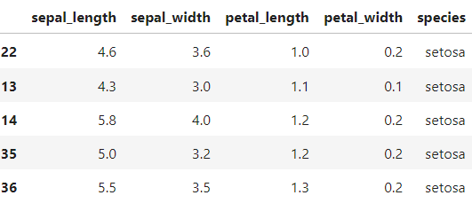
Pandas-Data frame operations
data.sort_values(by='petal_length’, ascending=True).head()
Sorting the index in the ascending manner

Slide 43
NumPy
NumPy is an acronym for Numerical Python.
NumPy library is majorly used for the functioning of arrays. It can also be used in linear algebra and matrices. The motive of the arrays is set by the list in Python.
In a field such as data science, speed and resources play a vital role. To overcome this disadvantage of the lists, the NumPy arrays are used.
The major difference which makes the NumPy arrays to be more prominent than the Python lists is the vectorized operations supported by the NumPy arrays and not by the Python lists.
ndarray is an array class used in NumPy.
All the items in the NumPy arrays are enclosed in square brackets and are initialized using lists.

Slide 44
NumPy
Creation of the NumPy arrays:
Various NumPy arrays can be created based on the ranks, using a tuple or a list.
In[26]:
import numpy as np
arr1 = np.array(['a', 'b', 'c', 'd'])
print("Rank 1 Array : \n", arr1)
print()
arr2 = np.array([[1, 2, 3], ['a', 'b', 'c']])
print("Rank 2 Array: \n", arr2)
print()

Slide 45
NumPy
Creation of the NumPy arrays:
arr3 = np.array((4, 5, 6))
print("\n Tuple passed Array:\n", arr3)
Out[26]:
Rank 1 Array :
['a' 'b' 'c' 'd']
Rank 2 Array:
[['1' '2' '3']
['a' 'b' 'c']]
Tuple passed Array: [4 5 6]

Slide 46
NumPy-Accessing the array using its index
In [27]:
import numpy as np
arr=np.arange(10)
print(arr)
print("arr[:5]", arr[:5])
#prints elements till the 4th position
print("arr[3:]", arr[3:])
#prints elements from the 3rd position to the end
print("arr[::5]",arr[::5])
#prints elements divisible by 5
print("arr[1::2]", arr[1::2])
#prints elements starting from the 1st position and step by 2
arr1= np.array([[1,2,3],[4,5,6],[7, 8, 9]])
print("Initial Array: ")
print(arr1)
print()
sliced_arr = arr1[:2,:2]
print ("Array with first 2 rows and 2 columns", sliced_arr)

Slide 47
NumPy-Accessing the array using its index
Out[27]:
[0 1 2 3 4 5 6 7 8 9]
arr[:5] [0 1 2 3 4]
arr[3:] [3 4 5 6 7 8 9]
arr[::5] [0 5]
arr[1::2] [1 3 5 7 9]
Initial Array:
[[1 2 3]
[4 5 6]
[7 8 9]]
Array with first 2 rows and 2 columns:
[[1 2]
[4 5]]

Slide 48
NumPy-Basic array operations
The NumPy array also allows us to perform some basic operations such as addition, subtraction, etc.
Unary and binary operations also can be performed on the arrays.
In[28]:
import numpy as np
arr1 = np.array([1,2,3,4])
arr2 = np.array([6,7,8,9])
print("arr1:", arr1)
print ("arr1 after adding 2 to every element:", arr1 + 2)
print("\narr2:", arr2)
print("arr1 after subtracting 1 from every element:", arr2-1)
print ("\nSum of all array elements in arr1: ", arr1.sum())
print ("\nArray sum:\n", arr1 + arr2)

Slide 49
NumPy-Basic array operations
Out:
arr1: [1 2 3 4]
arr1 after adding 2 to every element: [3 4 5 6]
arr2: [6 7 8 9]
arr1 after subtracting 1 from every element: [5 6 7 8]
Sum of all array elements in arr1: 10
Array sum:
[ 7 9 11 13]

Slide 50
Module 5: Platforms for Data Science
Basics of Python for Data Science
Python Libraries: Data Frame Manipulation with numpy and pandas
Exploration Data Analysis with Python
Time Series Data
Clustering with Python
ARCH and GARCH
Dimensionality Reduction
Python IDEs for Data Science

Slide 51
Exploration Data Analysis with Python
EDA is a technique that evaluates datasets to contextualize their primary characteristics, often with visualization.
In short, we explore the dataset. Similarly, when constructing an ML model, data exploration is very important to figure out the sensibility in your dataset.
The main objective of EDA is to make it competent to work with any ML algorithm.
Objectives of EDA:
Description of the dataset
Removing corrupted data
Handling outliers
Evaluation of the relationship between variables through visualization.

Slide 52
Exploration Data Analysis with Python
Exploratory Data Analysis(EDA) is the main step in the process of various data analysis.
It helps data to visualize the patterns, characteristics, and relationships between variables.
Python provides various libraries used for EDA such as NumPy, Pandas, Matplotlib, Seaborn, and Plotly.

Slide 53
1. Description of the dataset
A data scientist should always know the data and other vital statistics of the dataset before moving further.
Describe() function in Python can be used.
Applying the describe() function to a DataFrame in pandas provides comprehensive statistics, summarizing various factors, such as the dispersion, the shape using count, std, mean, etc.

Slide 54
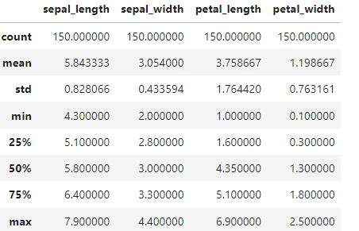
Description of the dataset
import pandas as pd
import numpy as np
data=pd.read_csv('data//iris.csv')
data.describe()

Slide 55
2. Removing corrupted data
Missing values when not handled properly can reduce the excellence in the performance matrix.
This can also lead to the false classification which can harm our model thus built.
Missing or NULL values can be handled in various ways:
Drop NULL or missing values:
Although this is the simplest way to handle missing or NULL values, it is usually not used as it shrinks the dataset by deleting such observations.
In Python, the dropna() function is used to delete the missing values from the dataset.

Slide 56
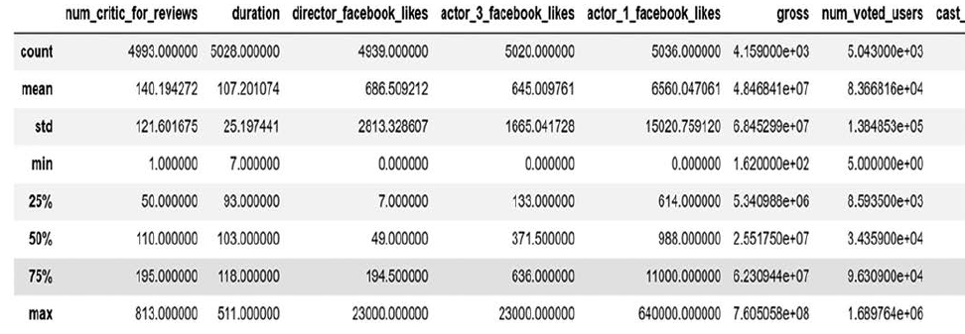
2. Removing corrupted data
In[29]:df.shape
Out[29]: (5043, 28)
In[30]:df.dropna()
df.shape
Out[30]: (5043,28)
The above code snippet denotes that there are no missing values in the dataset.

Slide 57
Fill missing values
In this method, missing values are replaced with a statistic such as mean, median, mode, min, max, or even any user-defined value.
The fillna() function is used in Python for filling the missing values. Suppose, we have missing values in the above-used dataset, then the below code snippet depicts to replace the NULL/missing values with the mean of the data points in the dataset.
In[31]: df['duration']=df['duration'].fillna(df.mean())

Slide 58
Predict missing values with an ML algorithm
Predicting missing values is the most efficient way to handle the missing data.
One can use the regression model or classification model (depending on the dataset) to predict the missing data.

Slide 59
3.Handling outliers
Outliers are the data points that are far different from the crowd of data points.
This can be an indication of the variation in the dataset.
Outliers can be detected using boxplot, scatterplot, inter quartile range, and Z-score.

Slide 60
4.Evaluation of the relationship between variables through visualization
Visualization helps us understand the various relationship between features.
Some widely used techniques for data visualization in Python are the histograms and the heatmaps.
The histogram helps to assess probability distribution that is quite easy to interpret.
Python provides various options to build and plot histograms.
The heatmap is represented where the data points are denoted using colors.

Slide 61
Module 5: Platforms for Data Science
Basics of Python for Data Science
Python Libraries: Data Frame Manipulation with numpy and pandas
Exploration Data Analysis with Python
Time Series Data
Clustering with Python
ARCH and GARCH
Dimensionality Reduction
Python IDEs for Data Science

Slide 62
Time Series Data
Time series data is a type of structured data and is used in various domains, such as accounting, ecology, economics, neuroscience, etc.
Time series can be referred to as anything and everything that is measured in the form of time.
The data points in time series appear at regular intervals according to some rules.
Time series may also be uneven without an even fixed unit of time.

Slide 63
Date and time data come in various types:
Timestamps – The timestamp refers to particular instants in time (e.g., July 24, 2020, at 8:00 a.m.)
Time Intervals and Periods – Time intervals and periods refer to a time length between the initial and the final point. Periods generally refer to a specific case of time intervals where each time interval is of a uniform length and does not coincide (e.g., 24-hour period of days)
Time Deltas or Durations – It refers to an exact length of time (e.g., a duration of 12.43 seconds)

Slide 64
Dates and Times in Python
Native Python datetime:
There exist data types for date and time and also calendar functionality in the Python standard library. The datetime is broadly used in time series:
In[32]: from datetime import datetime
date_now = datetime.now()
date_now
Out[32]: datetime.datetime(2024, 3, 14, 7, 16, 48, 597761)
The datetime object stores both the date and time up to the microsecond.
In[33]: from datetime import datetime
now = datetime.now()
now.year, now.month, now.day
Out[33]: (2024, 3, 14)

Slide 65
Dates and Times in Python
You can parse dates from a variety of string formats using the date util module:
In[34]:
from dateutil import parser
date = parser.parse("8th of August, 2020")
date
Out[34]:
datetime.datetime(2020, 8, 8, 0, 0)

Slide 66
Datetime64 of NumPy
The data type “datetime64” encrypts dates as 64-bit integers, allowing data arrays to be displayed very efficiently.
In[35]: import numpy as np
date = np.array('2017–08-04', dtype=np.datetime64)
date
Out[35]: array('2017–08-04', dtype='datetime64[D]')
We can even perform vectorized operation on the formatted date:
In[36]: date + np.arange(8)
Out[36]: array(['2017–08-04', '2017–08-05', '2017–08-06',
'2017–08-07',
'2017-08-08', '2017-08-09', '2017-08-10',
'2017-08-11'],
dtype='datetime64[D]')

Slide 67
pandas Time Series: Indexing by Time
Using the pandas time series module, you
can index your data using timestamps.
In[37]: import pandas as pd
index = pd.DatetimeIndex(['2017-07-04', '2018–09–12', '2015-02-11', '2015–08-04'])
data = pd.Series([0, 1, 2, 3], index=index) data
Out[37]: 2017-07-04 0
2018-09-12 1
2015-02-11 2
2015-08-04 3
dtype: int64
We can also obtain the sliced data by passing a year to get data from that year.
In[38]: date[‘2015’]
Out[38]: 2015-02-11 2
2015-08-04 3
dtype: int64

Slide 68
pandas Time Series: Indexing by Time
Using the pandas time series module, you
can index your data using timestamps.
In[37]: import pandas as pd
index = pd.DatetimeIndex(['2017-07-04', '2018–09–12', '2015-02-11', '2015–08-04'])
data = pd.Series([0, 1, 2, 3], index=index) data
Out[37]: 2017-07-04 0
2018-09-12 1
2015-02-11 2
2015-08-04 3
dtype: int64
We can also obtain the sliced data by passing a year to get data from that year.
In[38]: date[‘2015’]
Out[38]: 2015-02-11 2
2015-08-04 3
dtype: int64

